Slide 1
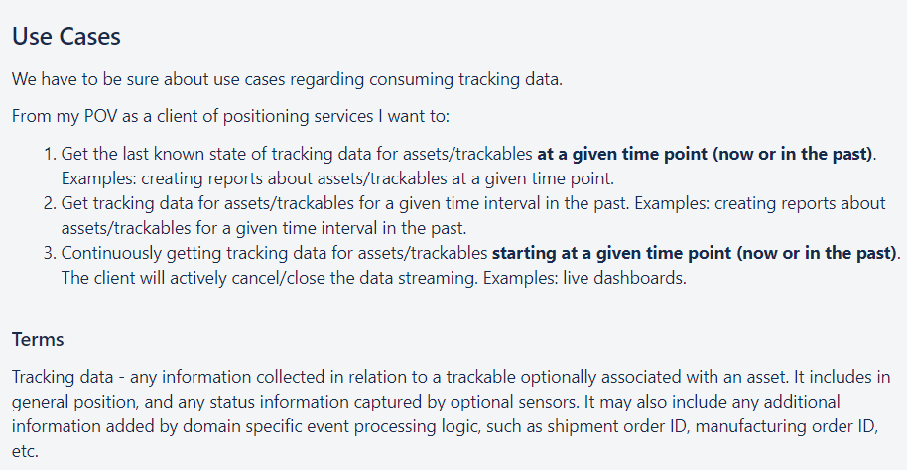
Time
Now
1.
1.
1.
1. Reports
2.
2.
2.
2. Reports
2.
3. Dashboard (Situational Awareness), e.g. Notifications
3.
Tracking Data – time point - Now or in the past
How far back? Configurable?
Reporting (any format)
Tracking data – time inverval – Now or in the past
How far back? Configurable?
Reporting (any format)
3. Continious tracking data
….
„Live“ view of data (Dashboard)

